Slide 1
Code Sample and Github Link

Slide 2
Github Link
This is the link of the project:
https://github.com/servicegeneral/servicegeneral
Location of the code:
https://github.com/servicegeneral/servicegeneral/tree/main/servicegeneral-api
https://github.com/servicegeneral/servicegeneral/tree/main/servicegeneral-ui
https://github.com/servicegeneral/servicegeneral/tree/main/servicegeneral-dbscripts

Slide 3
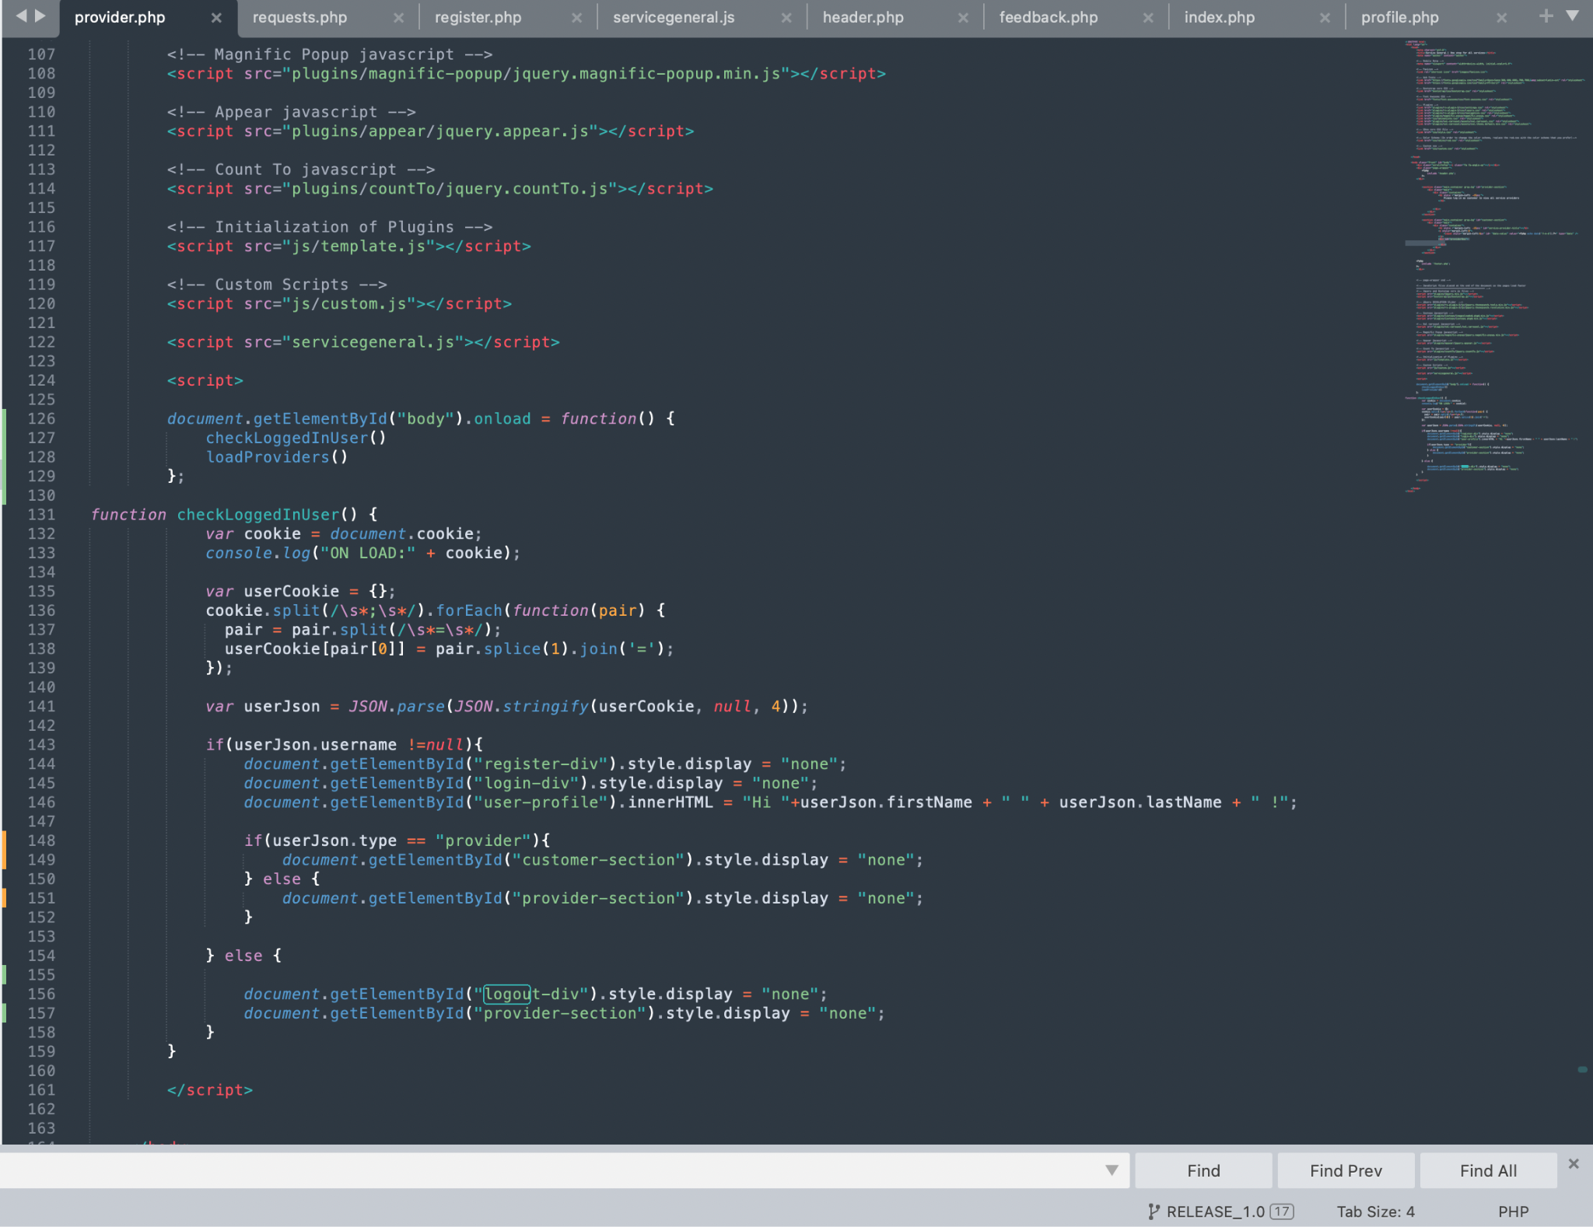
Github Code Screenshot and code samples

Slide 4
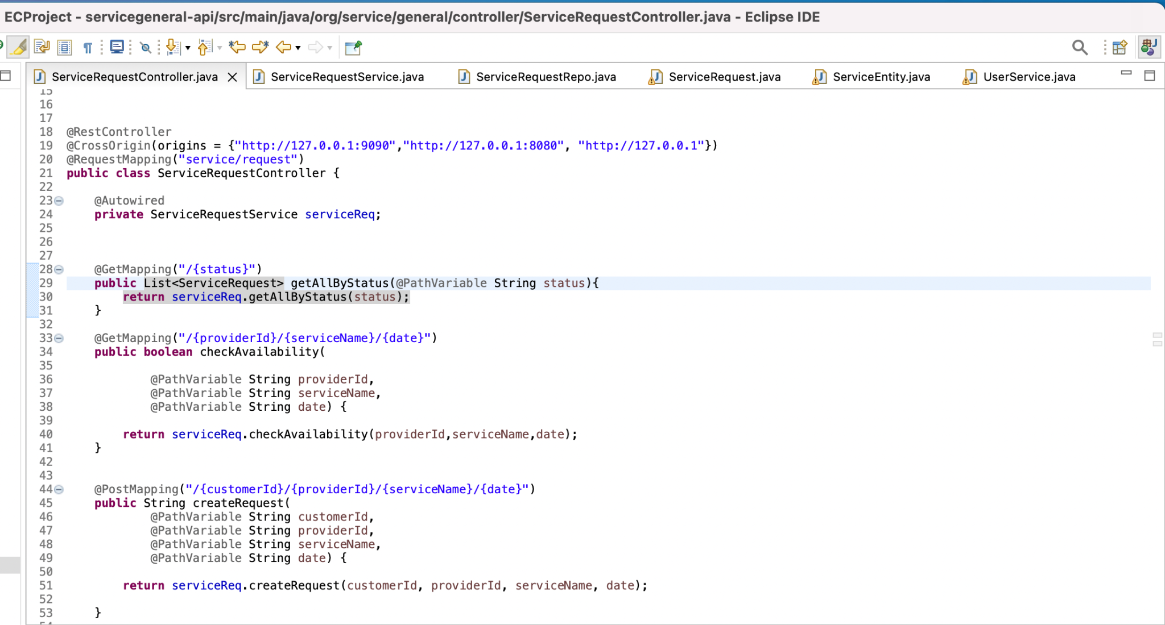

Slide 5
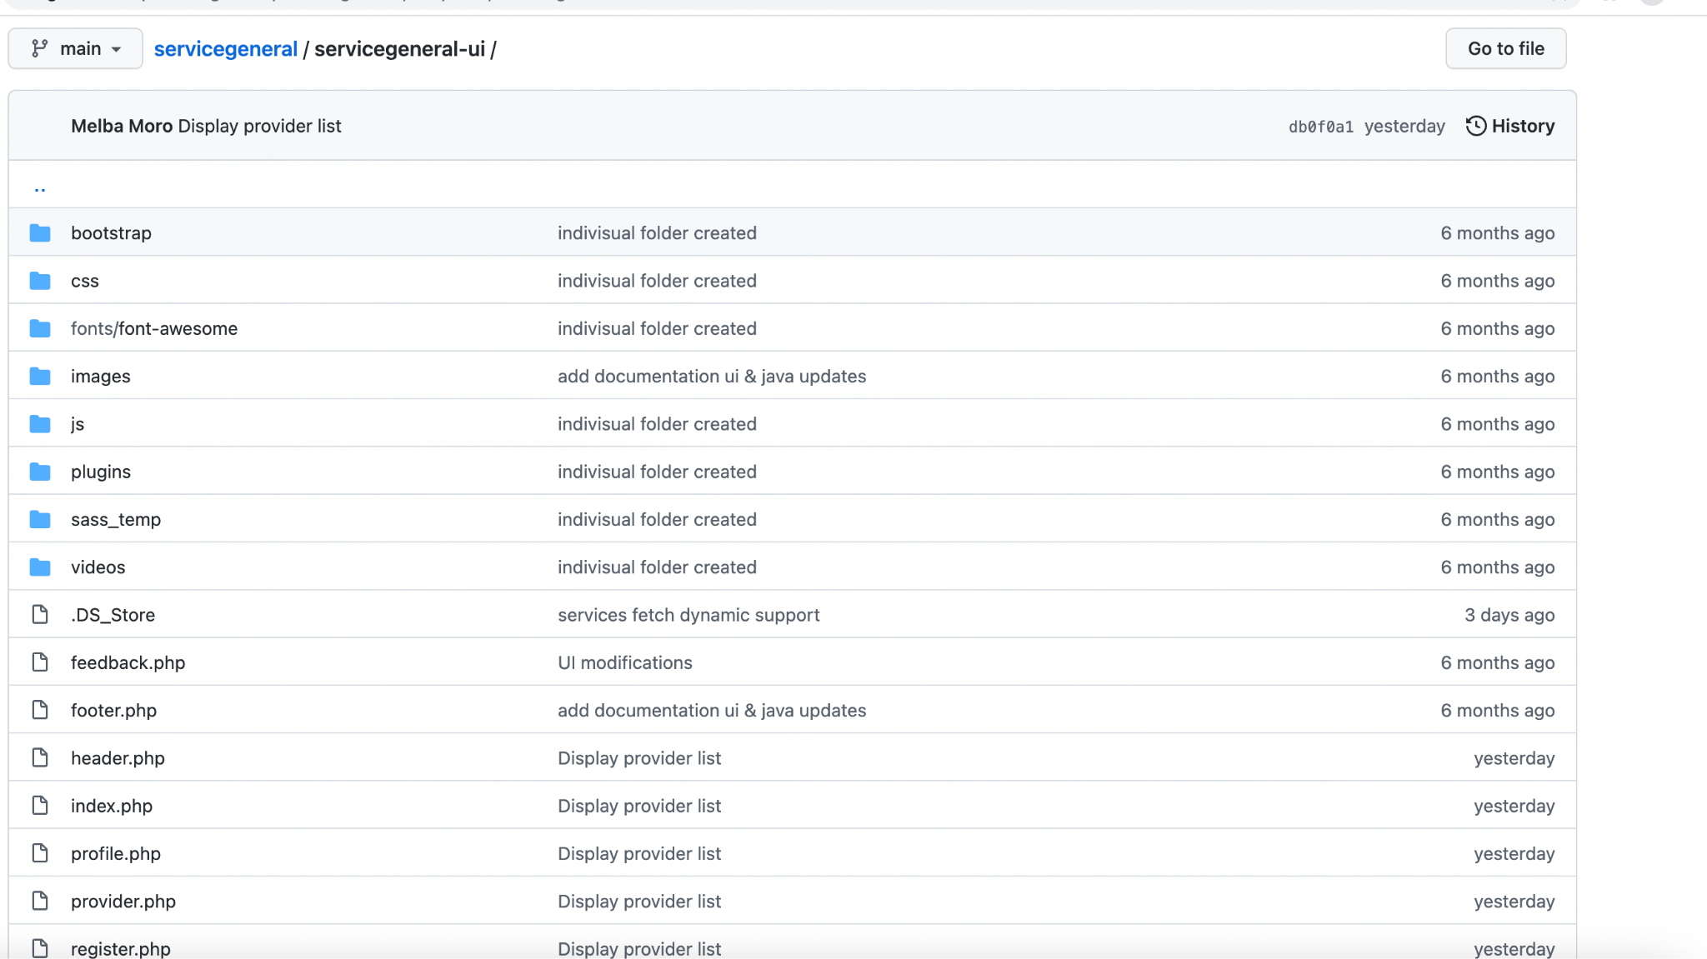

Slide 6
